Slide 2
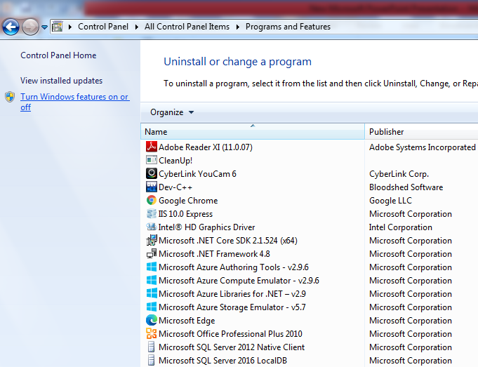
Install in control panel

Slide 3
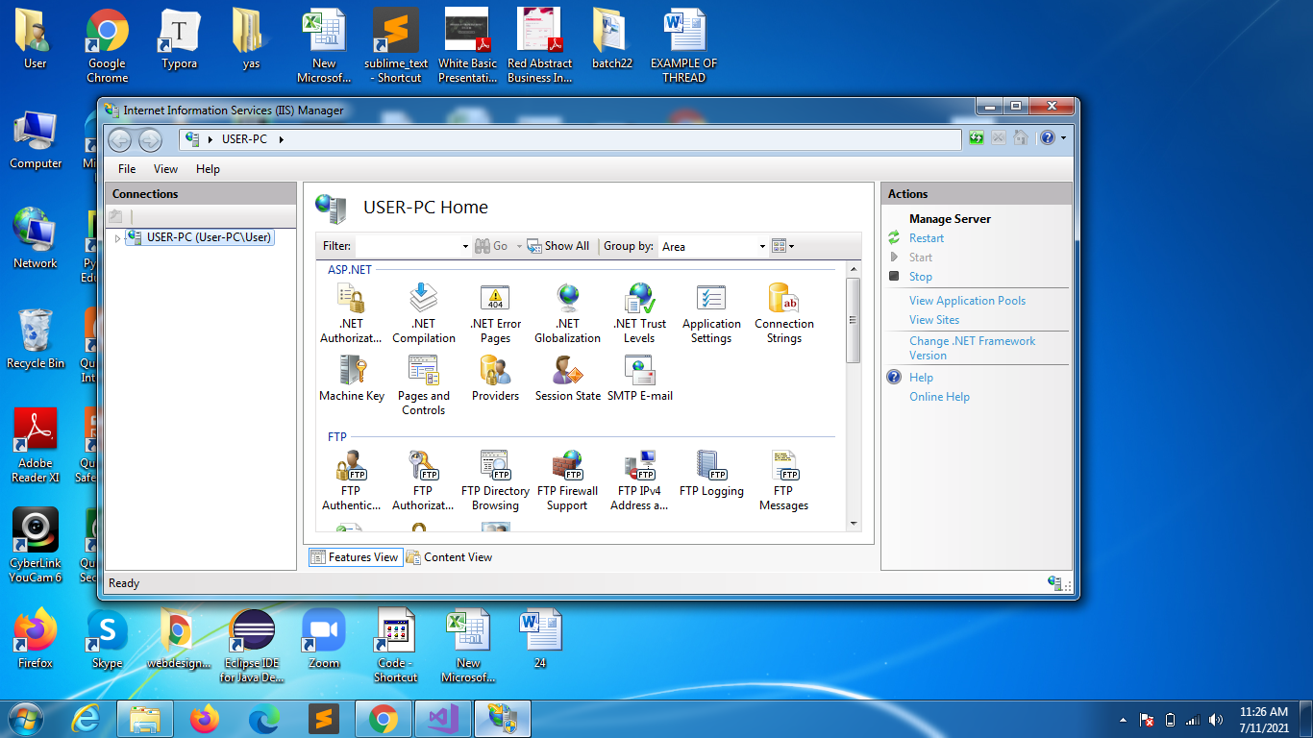
In the command prompt
Win+run
Type: inetmgr

Slide 4
Techniques
Coding techniques
Inline coding
Code behind
Webform / webpage
Designer code
Business logic

Slide 5
Inline coding
Both of the things below will be in single file with below extension
.aspx page
designer Code
busniess logic

Slide 6
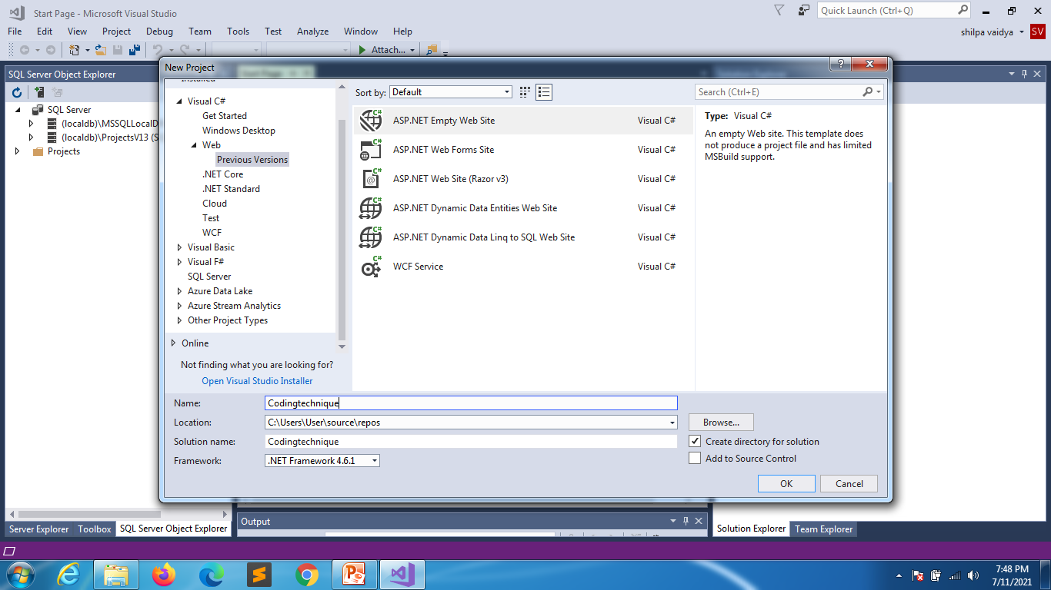
Create a web project

Slide 7
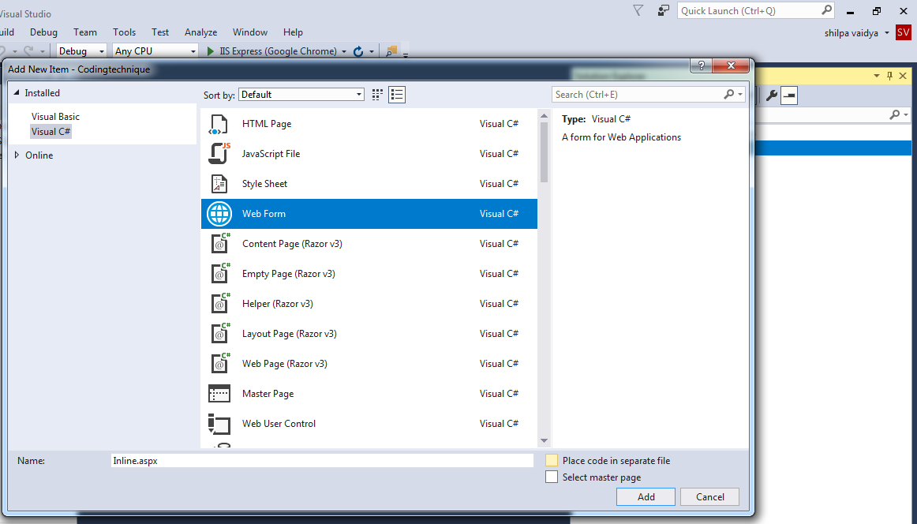
Uncheck this box

Slide 8
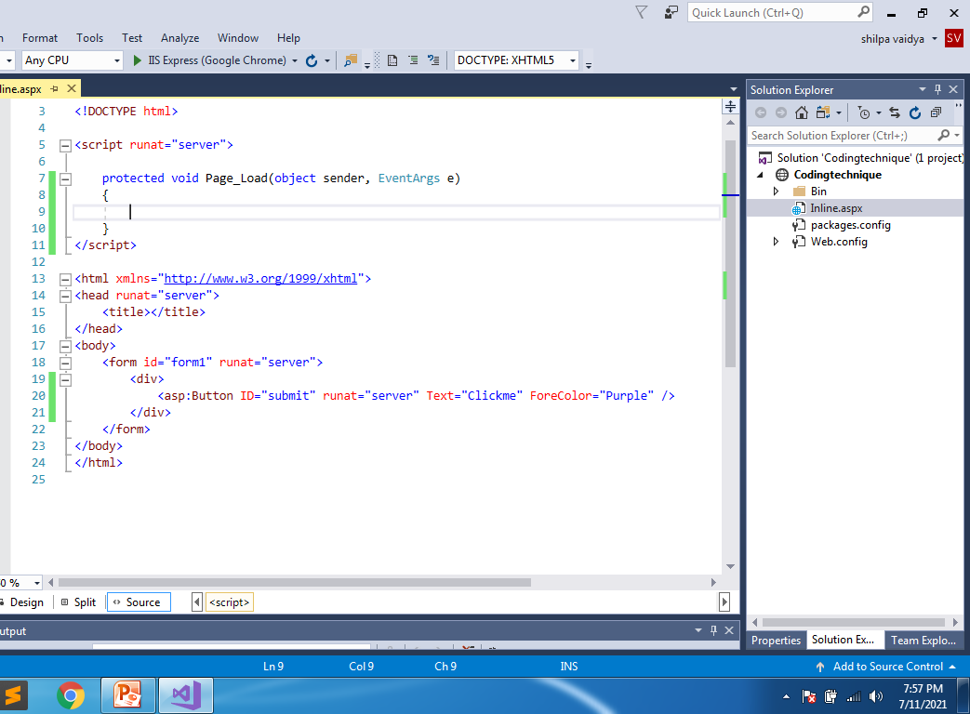
Type this line

Slide 9
Code behind
There are 2 separate files here
Codebehind.aspx
Designer code
Codebehind.aspx.cs
Business logic

Slide 10
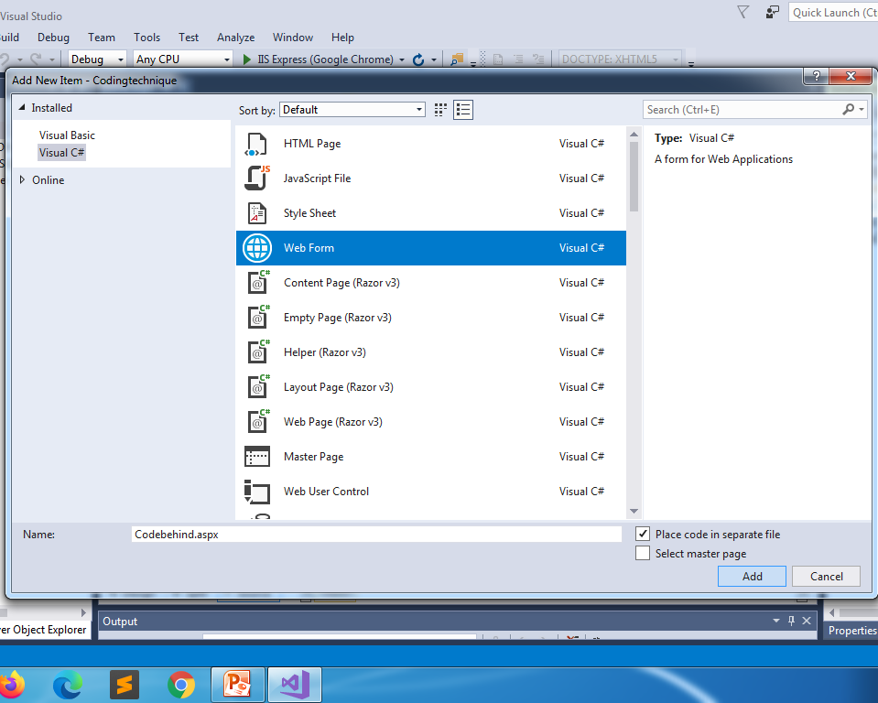
check this box

Slide 11
Codebehind.aspx
<%@ Page Language="C#" AutoEventWireup="true" CodeFile="Codebehind.aspx.cs" Inherits="Codebehind" %>
<!DOCTYPE html>
<html xmlns="http://www.w3.org/1999/xhtml">
<head runat="server">
<title></title>
</head>
<body>
<form id="form1" runat="server">
<div>
<asp:Button ID="Button1" runat="server" Text="Click me" ForeColor="green" OnClick="Button1_Click" />
</div>
</form>
</body>
</html>

Slide 12
Codebehind.aspx.cs
using System;
using System.Collections.Generic;
using System.Linq;
using System.Web;
using System.Web.UI;
using System.Web.UI.WebControls;
public partial class Codebehind : System.Web.UI.Page
{
protected void Page_Load(object sender, EventArgs e)
{
}
protected void Button1_Click(object sender, EventArgs e)
{
Response.Write("button is clicked");
}
}

Slide 13
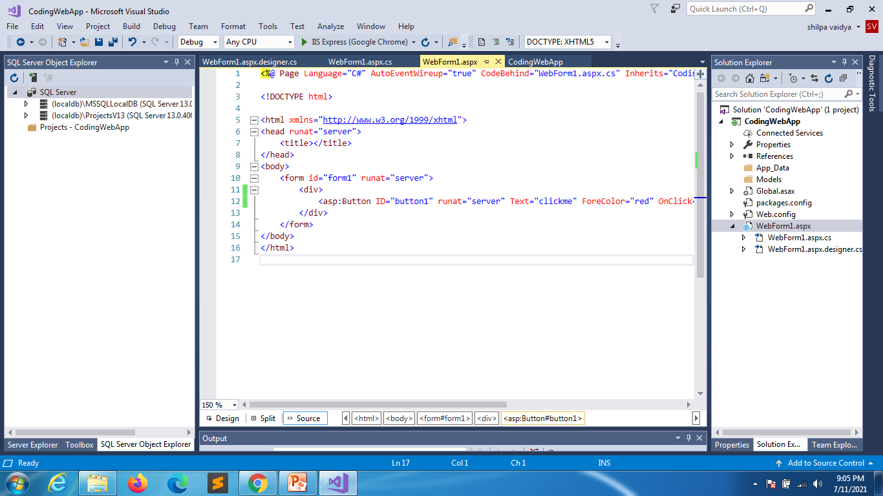
Create web app application

Slide 14
<%@ Page Language="C#" AutoEventWireup="true" CodeBehind="WebForm1.aspx.cs" Inherits="CodingWebApp.WebForm1" %>
<!DOCTYPE html>
<html xmlns="http://www.w3.org/1999/xhtml">
<head runat="server">
<title></title>
</head>
<body>
<form id="form1" runat="server">
<div>
<asp:Button ID="button1" runat="server" Text="clickme" ForeColor="red" OnClick="button1_Click" />
</div>
</form>
</body>
</html>

Slide 15
using System;
using System.Collections.Generic;
using System.Linq;
using System.Web;
using System.Web.UI;
using System.Web.UI.WebControls;
namespace CodingWebApp
{
public partial class WebForm1 : System.Web.UI.Page
{
protected void Page_Load(object sender, EventArgs e)
{
}
protected void button1_Click(object sender, EventArgs e)
{
Response.Write("hey u");
}
}
}

Slide 16
Asp .net controls
Server controls
HTML controls

Slide 17
<%@ Page Language="C#" AutoEventWireup="true" CodeBehind="WebForm1.aspx.cs" Inherits="CodingWebApp.WebForm1" %>
<!DOCTYPE html>
<html xmlns="http://www.w3.org/1999/xhtml">
<head runat="server">
<title></title>
</head>
<body>
<form id="form1" runat="server">
<div>
<asp:TextBox ID="Textbox1" runat="server"></asp:TextBox>
<asp:Button ID="button1" runat="server" Text="clickme" ForeColor="red" OnClick="button1_Click" />
<br />
<input type="text" name="textbox2" />
<input type="submit" name="submit1" value="SUBMIT" />
</div>
</form>
</body>
</html>

Slide 18
using System;
using System.Collections.Generic;
using System.Linq;
using System.Web;
using System.Web.UI;
using System.Web.UI.WebControls;
namespace CodingWebApp
{
public partial class WebForm1 : System.Web.UI.Page
{
protected void Page_Load(object sender, EventArgs e)
{
}
protected void button1_Click(object sender, EventArgs e)
{
string name1 = Textbox1.Text;
Response.Write(name1);
string name = Request.Form["textbox2"];
Response.Write(name);
}
}
}

Slide 19
rendering
Process of converting the Asp.net codes to html codes as browser doesn’t understand asp.net code.
Browser
Web server IIS
http://localhost/WebApplication1/
Render asp .net to html

Slide 20
Control
Properties
Methods
Events

Slide 21
Properties
Properties: attributes of control(like the custmization of its appearance)
BackColor
Font
BorderColor
BorderWidth

Slide 22
Method
Method is nothing but functions, means its performing some kind of action
Focus()
FindControl()
onLoad()

Slide 23
Event
An event is a timeperiod when an action has to be performed
using System;
using System.Collections.Generic;
using System.Linq;
using System.Web;
using System.Web.UI;
using System.Web.UI.WebControls;
using System.Drawing;
namespace CodingWebApp
{
public partial class WebForm2 : System.Web.UI.Page
{
protected void Page_Load(object sender, EventArgs e)
{
TextBox1.Focus();
}
protected void Button1_Click(object sender, EventArgs e)
{
string name = TextBox1.Text;
TextBox1.BackColor = Color.Black;
TextBox1.ForeColor = Color.Goldenrod;
}
}
}

Slide 24
Postback
Postback
Postback submission
Ispostback
AutoPostback

Slide 25
Postback
PostBack is the name given to the process of submitting an ASP.NET page to the server for processing.
PostBack is done if certain credentials of the page are to be checked against some sources (such as verification of username and password using database).
This is something that a client machine is not able to accomplish and thus these details have to be 'posted back' to the server.
False if it is first request and true it it is next requests

Slide 26
Webform1.aspx.cs
using System;
using System.Collections.Generic;
using System.Linq;
using System.Web;
using System.Web.UI;
using System.Web.UI.WebControls;
namespace CodingWebApp
{
public partial class WebForm1 : System.Web.UI.Page
{
protected void Page_Load(object sender, EventArgs e)
{
Response.Write(this.IsPostBack);
//first request will always be false then onwards it will be true
}
protected void button1_Click(object sender, EventArgs e)
{
string name1 = Textbox1.Text;
Response.Write(name1);
string name = Request.Form["textbox2"];
Response.Write(name);
}
}
}

Slide 27
All the data that is associated with form and its controls is submitted to the page on server
By default button is designed for submitting a page to server
Other controls like TextBox, ChexkBox, DropDownList, RadioButton is also capable for submitting the page to the server provided AutoPostBack property is set to true.
By default AutoPostBack property is false.

Slide 28
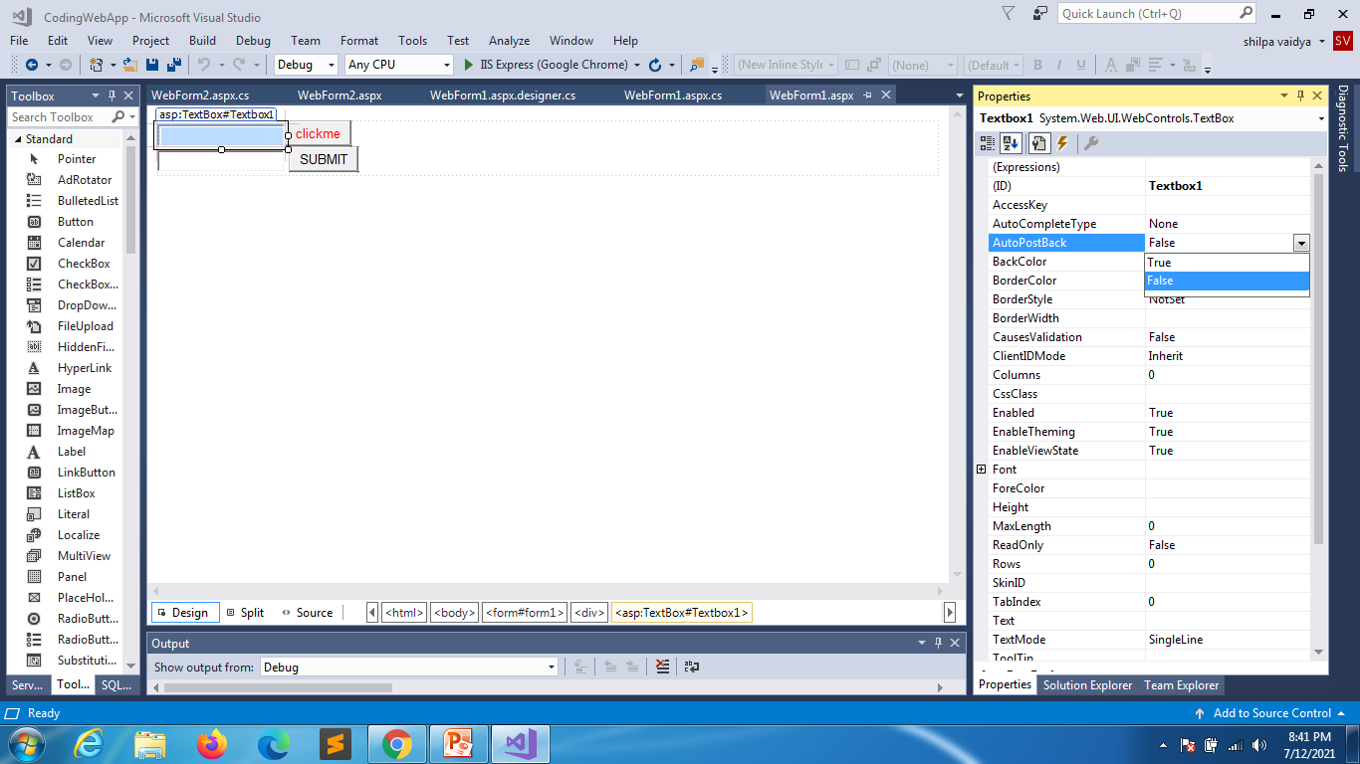
Textbox
It can also submit data to the server provided
AutoPostBack should be set as true
And run the code data is submitted every time text is changed

Slide 29
Postback events and Cache events
Page has series of events
They will fire everytime the page is loaded
They will also fire in postback request of the page.
Postback events
It will be fired only when page is posted back to server, i.e second request onwards.
Cache events
When any event handlers to controls which are not capable of submitting page to server when the events fire based on client action ges stored in cache memory and fires after the page is submitted to server.
Order in which its fired
page events will fire
Then cache events fire
Then Postback events fire

Slide 30
<%@ Page Language="C#" AutoEventWireup="true" CodeBehind="WebForm1.aspx.cs" Inherits="Postbackcache.WebForm1" %>
<!DOCTYPE html>
<html xmlns="http://www.w3.org/1999/xhtml">
<head runat="server">
<title></title>
</head>
<body>
<form id="form1" runat="server">
<div>
<asp:Button ID="Button1" runat="server" OnClick="Button1_Click" Text="Button1" />
<br />
<br />
<asp:Button ID="Button2" runat="server" OnClick="Button2_Click" style="height: 26px" Text="Button2" />
</div>
</form>
</body>
</html>

Slide 31
using System;
using System.Collections.Generic;
using System.Linq;
using System.Web;
using System.Web.UI;
using System.Web.UI.WebControls;
namespace Postbackcache
{
public partial class WebForm1 : System.Web.UI.Page
{
protected void Page_Load(object sender, EventArgs e)
{
Response.Write("<br/>HELLO");
}
protected void Button1_Click(object sender, EventArgs e)
{
Response.Write("<br/>Button 1 is clicked");
}
protected void Button2_Click(object sender, EventArgs e)
{
Response.Write("<br/>Button 2 is clicked");
}
}
}

Slide 32
AutoPostBack set to true for text box
using System;
using System.Collections.Generic;
using System.Linq;
using System.Web;
using System.Web.UI;
using System.Web.UI.WebControls;
namespace Postbackcache
{
public partial class WebForm2 : System.Web.UI.Page
{
protected void Page_Load(object sender, EventArgs e)
{
}
protected void TextBox1_TextChanged(object sender, EventArgs e)
{
Response.Write("value = " + TextBox1.Text);
}
}
}

Slide 33
using System;
using System.Collections.Generic;
using System.Linq;
using System.Web;
using System.Web.UI;
using System.Web.UI.WebControls;
namespace Postbackcache
{
public partial class WebForm2 : System.Web.UI.Page
{
protected void Page_Load(object sender, EventArgs e)
{
Response.Write("Page fired load<br/>");
}
protected void TextBox1_TextChanged(object sender, EventArgs e)
{
Response.Write("Cached event of textbox = " + TextBox1.Text+"<br/>");
}
protected void Button1_Click(object sender, EventArgs e)
{
Response.Write("Post back button event is fired<br/>");
}
}
}

Slide 34
Postback vs Cross Page post back
Postback is calling back itself and submitting data to itself.
LoginFormPostback.aspx
crossPage Page post back -> calling and submitting data to another page
LoginFormPostback.aspx =>Validate.aspx

Slide 35
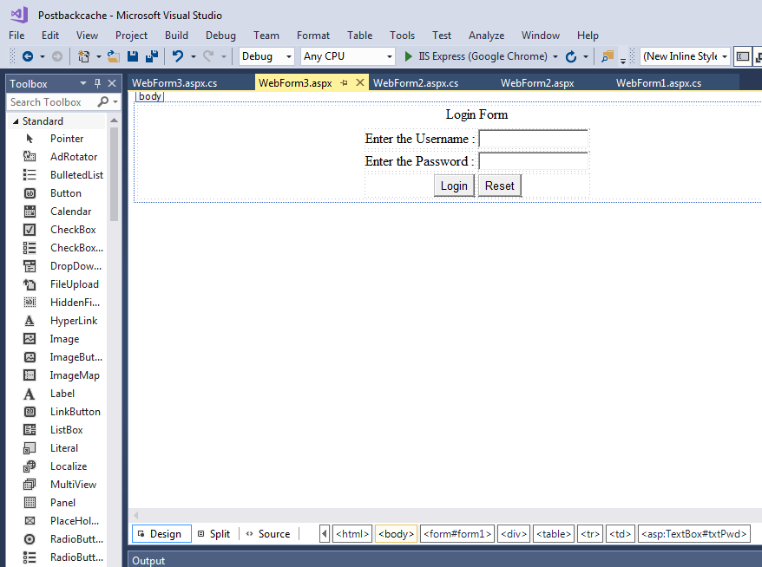
Postback forms n tables
design

Slide 36
<%@ Page Language="C#" AutoEventWireup="true" CodeBehind="WebForm3.aspx.cs" Inherits="Postbackcache.WebForm3" %>
<!DOCTYPE html>
<html xmlns="http://www.w3.org/1999/xhtml">
<head runat="server">
<title></title>
</head>
<body>
<form id="form1" runat="server">
<div>
<table align="center">
<caption>Login Form</caption>
<tr>
<td>Enter the Username :</td>
<td> <asp:TextBox ID="txtName" runat="server"></asp:TextBox> </td>
</tr>
<tr>
<td>Enter the Password :</td>
<td> <asp:TextBox ID="txtPwd" runat="server" TextMode="Password"></asp:TextBox> </td>
</tr>
<tr>
<td align="right"><asp:Button ID="btnLogin" runat="server" Text="Login" OnClick="btnLogin_Click" /></td>
<td><asp:Button ID="btnReset" runat="server" Text="Reset" OnClick="btnReset_Click" /></td>
</tr>
</table>
</div>
</form>
</body>
</html>
Source for design

Slide 37
using System;
namespace Postbackcache
{
public partial class WebForm3 : System.Web.UI.Page
{
protected void Page_Load(object sender, EventArgs e)
{
if (!this.IsPostBack)
txtName.Focus();
}
protected void btnLogin_Click(object sender, EventArgs e)
{
if (txtName.Text == "admin" && txtPwd.Text == "admin")
Response.Write("valid user");
else
Response.Write("invalid user");
}
protected void btnReset_Click(object sender, EventArgs e)
{
txtName.Text = "";
txtPwd.Text = "";
txtName.Focus();
}
}
}

Slide 38
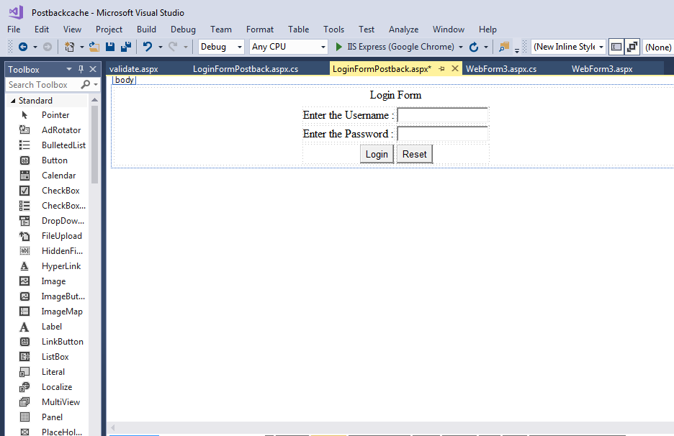
crossPage

Slide 39
source
<%@ Page Language="C#" AutoEventWireup="true" CodeBehind="LoginFormPostback.aspx.cs" Inherits="Postbackcache.WebForm4" %>
<!DOCTYPE html>
<html xmlns="http://www.w3.org/1999/xhtml">
<head runat="server">
<title></title>
</head>
<body>
<form id="form1" runat="server">
<div>
<table align="center">
<caption>Login Form</caption>
<tr>
<td>Enter the Username :</td>
<td> <asp:TextBox ID="txtName" runat="server"></asp:TextBox> </td>
</tr>
<tr>
<td>Enter the Password :</td>
<td> <asp:TextBox ID="txtPwd" runat="server" TextMode="Password"></asp:TextBox> </td>
</tr>
<tr>
<td align="right"><asp:Button ID="btnLogin" runat="server" Text="Login" /></td>
<td><asp:Button ID="btnReset" runat="server" Text="Reset" OnClick="btnReset_Click" /></td>
</tr>
</table>
</div>
</form>
</body>
</html>

Slide 40
using System;
using System.Collections.Generic;
using System.Linq;
using System.Web;
using System.Web.UI;
using System.Web.UI.WebControls;
namespace Postbackcache
{
public partial class WebForm4 : System.Web.UI.Page
{
protected void Page_Load(object sender, EventArgs e)
{
if (!IsPostBack)
txtName.Focus();
}
protected void btnReset_Click(object sender, EventArgs e)
{
txtName.Text = txtPwd.Text = "";
txtName.Focus();
}
}
}

Slide 41
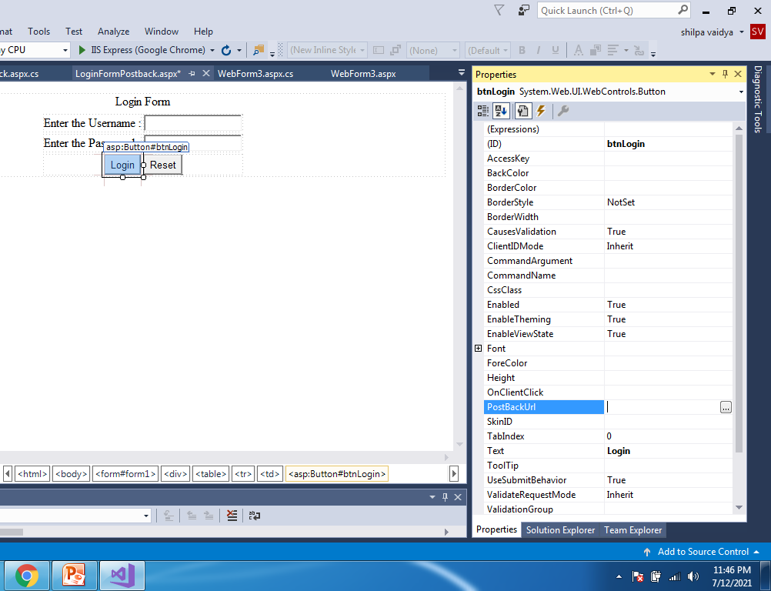
Create Validate.aspx page

Slide 42
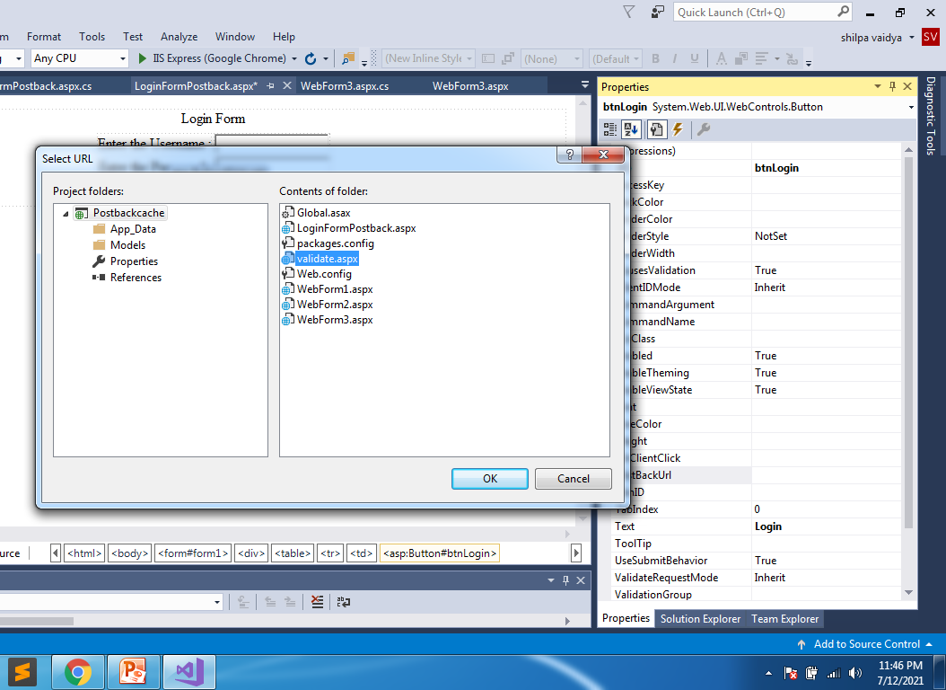

Slide 43
Validate.aspx.cs
using System;
using System.Collections.Generic;
using System.Linq;
using System.Web;
using System.Web.UI;
using System.Web.UI.WebControls;
namespace Postbackcache
{
public partial class WebForm4 : System.Web.UI.Page
{
protected void Page_Load(object sender, EventArgs e)
{
if (!IsPostBack)
txtName.Focus();
}
protected void btnReset_Click(object sender, EventArgs e)
{
txtName.Text = txtPwd.Text = "";
txtName.Focus();
}
}
}

Slide 44
Submitting form to multiple pages
LoginFormCrossPagePostBack -→Validate.aspx
Login.aspx
Valid →Success.aspx
Invalid → Failure.aspx

Slide 45
using System;
namespace Postbackcache
{
public partial class Login : System.Web.UI.Page
{
protected void Page_Load(object sender, EventArgs e)
{
if (!IsPostBack)
txtName.Focus();
}
protected void btnLogin_Click(object sender, EventArgs e)
{
if (txtName.Text == "admin" && txtPwd.Text == "admin")
Server.Transfer("Success.aspx");
else
Response.Redirect("Failure.aspx")
//you can also write Server.Transfer("Failure.aspx")
}
protected void btnReset_Click(object sender, EventArgs e)
{
txtName.Text = txtPwd.Text = "";
txtName.Focus();
}
}
}
Login---Page

Slide 46
Success.aspx
<%@ Page Language="C#" AutoEventWireup="true" CodeBehind="Success.aspx.cs" Inherits="Postbackcache.Success" %>
<!DOCTYPE html>
<html xmlns="http://www.w3.org/1999/xhtml">
<head runat="server">
<title></title>
<link href="css/custom.css" rel="stylesheet" />
</head>
<body>
<form id="form1" runat="server">
<div>
<h1 class="successtag"> This is success page</h1>
</div>
</form>
</body>
</html>

Slide 47
Failure
<%@ Page Language="C#" AutoEventWireup="true" CodeBehind="Failure.aspx.cs" Inherits="Postbackcache.Failure" %>
<!DOCTYPE html>
<html xmlns="http://www.w3.org/1999/xhtml">
<head runat="server">
<title></title>
<link href="css/custom.css" rel="stylesheet" />
</head>
<body>
<form id="form1" runat="server">
<div>
<h1 class="failuretag"> This is Failure page</h1>
</div>
</form>
</body>
</html>

Slide 48
Things to know
As soon as you hit the url , the first request -> getrequest
Server goes to server asking for the page(Login.aspx)Page opens up
Post request-> when you hit login button (data is submitted back to same page)
Later the data is transferred to Success.aspx
Success.aspx will send some info to server but its not known to browser

Slide 49
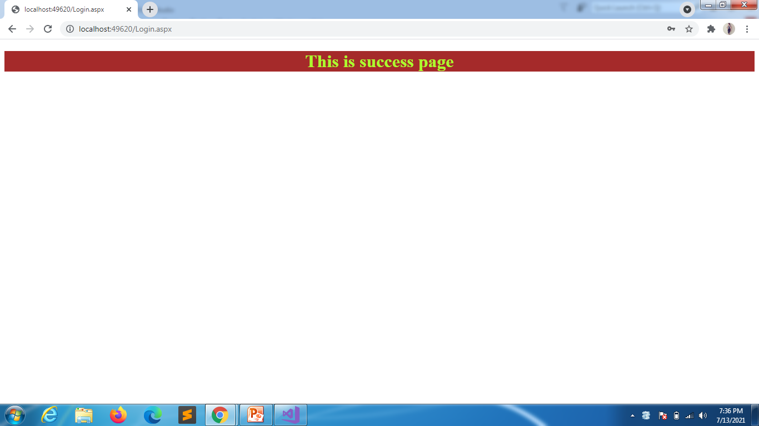
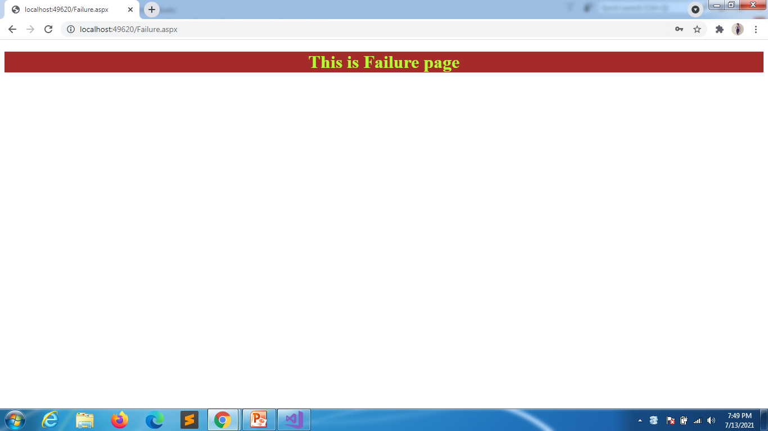
Even after the control goes to Login page the url stays same as Login.aspx
Failure the control goes to Failure.aspx

Slide 50
How the requests are done
Success.aspx
Browser | Web Server
First Request (Get) | Sends back Login.aspx
PostBack Request (Post) | Login.aspx transfer control to Success.aspx and response comes from Success.aspx
Failure.aspx
Browser | Web Server
First Request (Get) | Sends back Login.aspx
PostBack Request (Post) | Login.aspx redirects to Failure.aspx, a response is sent to browser (302) informing fresh request has to be sent to server for failure.aspx
First Request to Failure.aspx | Sends back Failure.aspx

Slide 51
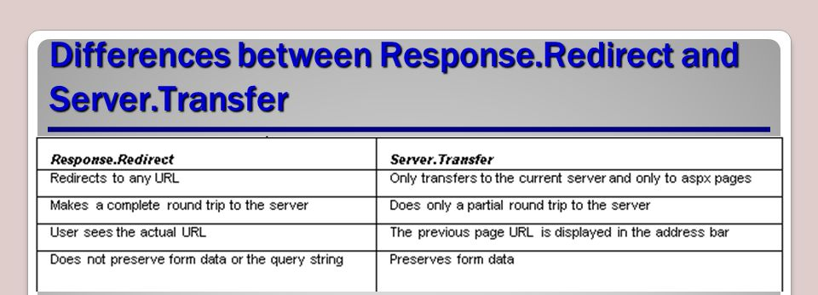
Server transfer vs Request.Redirect

Slide 52
Server transfer vs Request.Redirect
Server transfer | Request redirect
The transfer from 1 page to another happens on the server itself and is unknown to browser | The transfer from 1 page to another happens from browser to browser so it is aware of the page from where the output is coming
Faster because it happens on server | Slower due to additional round trip
Can transfer only .aspx pages | Can transfer .aspx or .html pages
Previous page object is available in memory and can be accessed in new page | Previous page object is not available in memory because the request is going from browser
Can transfer only the pages that are present in the current webserver | Can transfer to pages that are present under the sites of current web server or even an external web server

Slide 53
using System;
using System.Collections.Generic;
using System.Linq;
using System.Web;
using System.Web.UI;
using System.Web.UI.WebControls;
namespace Postbackcache
{
public partial class Success : System.Web.UI.Page
{
protected void Page_Load(object sender, EventArgs e)
{
// this property will provide access to previous page
// in the form of reference of login (parent page)
Page pp = PreviousPage;
Control ctrl = pp.FindControl("txtName");
TextBox tb = (TextBox)ctrl;
string name = tb.Text.ToString();
Response.Write("Hello " + name + " welcome");
}
}
}
Success.aspx.cs

Slide 54
Through response
using System;
namespace Postbackcache
{
public partial class Login : System.Web.UI.Page
{
protected void Page_Load(object sender, EventArgs e)
{
if (!IsPostBack)
txtName.Focus();
}
protected void btnLogin_Click(object sender, EventArgs e)
{
if (txtName.Text == "admin" && txtPwd.Text == "admin")
Server.Transfer("Success.aspx");
else
Response.Redirect("Failure.aspx?Name="+txtName.Text);
//you can also write Server.Transfer("Failure.aspx")
}
protected void btnReset_Click(object sender, EventArgs e)
{
txtName.Text = txtPwd.Text = "";
txtName.Focus();
}
}
}

Slide 55
Failure.aspx
using System;
using System.Collections.Generic;
using System.Linq;
using System.Web;
using System.Web.UI;
using System.Web.UI.WebControls;
namespace Postbackcache
{
public partial class Failure : System.Web.UI.Page
{
protected void Page_Load(object sender, EventArgs e)
{
string name = Request.QueryString["Name"];
Response.Write("Hey " + name + " Dude u are not valid user");
}
}
}

Slide 56
Login.aspx
protected void btnLogin_Click(object sender, EventArgs e)
{
if (txtName.Text == "admin" && txtPwd.Text == "admin")
Server.Transfer("Success.aspx");
else
Response.Redirect("Failure.aspx?Name="+txtName.Text + "&Pwd="+txtPwd.Text);
//you can also write Server.Transfer("Failure.aspx")
}
Since password is sensitive we usually don’t use this

Slide 57
State Management
Web applications are stateless when compared to windows application
Web applications are run on server so destroys the data every time you refresh
To over come this problem we are provided State Management
State Management
Process of maintaining state of values between multiple requests of page/s.
Values can be maintained on client side or server side

Slide 58
Client Machines
Hidden Fields
Query strings
View State & Control state
Cookies
Server side
Session
Applications

Slide 59
Design
<%@ Page Language="C#" AutoEventWireup="true" CodeBehind="WebForm1.aspx.cs" Inherits="TestProject.WebForm1" %>
<!DOCTYPE html>
<html xmlns="http://www.w3.org/1999/xhtml">
<head runat="server">
<title></title>
</head>
<body>
<form id="form1" runat="server">
<div>
<asp:Button ID="Button1" runat="server" Text="Button" OnClick="Button1_Click" />
</div>
</form>
</body>
</html>

Slide 60
using System;
namespace TestProject
{
public partial class WebForm1 : System.Web.UI.Page
{
int count = 0;
protected void Page_Load(object sender, EventArgs e)
{
}
protected void Button1_Click(object sender, EventArgs e)
{
count++;
Response.Write("Count = " + count);
}
}
}

Slide 61
Hidden fields

Slide 62
Design
<%@ Page Language="C#" AutoEventWireup="true" CodeBehind="WebForm1.aspx.cs" Inherits="TestProject.WebForm1" %>
<!DOCTYPE html>
<html xmlns="http://www.w3.org/1999/xhtml">
<head runat="server">
<title></title>
</head>
<body>
<form id="form1" runat="server">
<div>
<asp:Button ID="Button1" runat="server" Text="Button" OnClick="Button1_Click" />
<asp:HiddenField ID="hfcount" runat="server" Value="0" />
</div>
</form>
</body>
</html>

Slide 63
webForm1.aspx.cs
using System;
namespace TestProject
{
public partial class WebForm1 : System.Web.UI.Page
{
int count;
protected void Page_Load(object sender, EventArgs e)
{
}
protected void Button1_Click(object sender, EventArgs e)
{
count = int.Parse(hfcount.Value);
count += 1;
Response.Write("Count = " + count);
hfcount.Value = count.ToString();
}
}
}

